Slide 1

HNDIT2417
Mobile Application Development
Mobile Apps

Slide 2
Mobile App
A mobile app or mobile application is a computer program or software application designed to run on a mobile device such as a phone/tablet or watch.

Slide 3
Types of Apps
Native Apps
  Developed for one particular mobile device and is installed directly onto the device itself.
  Download them via app stores online or the app marketplace
    Apple App Store
    Google Play store
Web Aps
  Internet-enabled apps
  Accessible via the mobile device’s web browser
  Not downloaded onto the user’s mobile device.

Slide 4
Mobile Platforms and Apps
Each mobile platform offers the developer its own standardized SDK, development tools and other user interface elements, which they can use to develop their native apps.
  iOS uses Objective-C
  Android uses Java
  BlackBerry uses Java
  Windows Mobile uses C++
  Symbian uses C++
But for web apps developer has to aim multiple mobile platforms and multiple web browsers without standard SDK

Slide 5
Native Apps
Pros
  Easy to find(online store)
  Compatible with device’s built-in features
  Easier to work with and perform faster on the device
  Secure due to already approved on an app store
Cons
  App to be compatible with multiple mobile devices and platforms.
  Maintenance cost is high
  Need to approved on an app store ,may take time

Slide 6
Web Apps
Pros
  Always up to date
  No centralized store
  Newest version is always loads when a user accesses a web app
Cons
  Developing cost may high
  Not accessible the devices native features.
  Not systematically listed in any app store.
  Not always guaranteed to safe and secure.

Slide 7




Distribution Platforms
Google Play
Apple's App Store
Microsoft Store / Windows Store
Amazon Appstore
BlackBerry World
Samsung Apps
Opera Mobile Store

Slide 8
Web Apps
Common web applications include
  Web mail
  Online retail sales
  Online auctions
  Wikis
  Instant messaging services

Slide 9
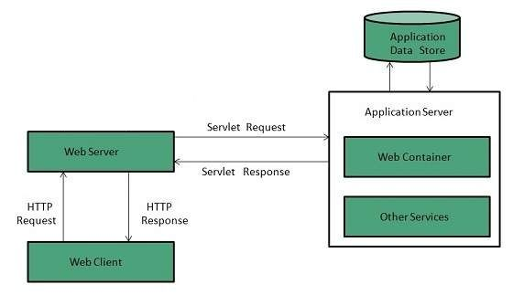
Web Apps

Slide 10
Wireless Application Protocol (WAP)
Introduced in 1999
Standard for accessing information over a mobile wireless network.
WAP browser is a web browser for mobile devices such as mobile phones that uses the protocol.
WML - WAP markup language, serve content from web sites. Required less processing power than HTML

Slide 11
WAP protocol suite
Wireless Application Environment (WAE)
Wireless Session Protocol (WSP)
Wireless Transaction Protocol (WTP)
Wireless Transport Layer Security (WTLS)
Wireless Datagram Protocol (WDP)
Any wireless data network

Slide 12
MMS
Multimedia Messaging Service (MMS)
Combination of WAP and SMS allowing multimedia content to and from a mobile phone over a cellular network.
Allowing the exchange of text messages greater than 160 characters in length.

Slide 13
Mobile Browser
Browser designed for use on a mobile device such as a mobile phone or PDA.
Mobile browsers are optimized so as to display Web content most effectively for small screens on portable devices.
Mobile browser software must be small and efficient to accommodate the low memory capacity and low-bandwidth of wireless devices
Recent mobile browsers can handle latest technologies also such as CSS 2.1, JavaScript, and Ajax

